Slide 1
Examining Early Effects of Tobacco 21 on Substance Use among Teenagers
Rahi Abouk¹, Prabal K. De², Michael F. Pesko³
¹William Patterson University
²The City College of New York and The Graduate Center
³Georgia State University
TOPS
April 29, 2021

Slide 2
Disclosures
Dr. Michael Pesko acknowledges funding from the National Institute on Drug Abuse of the National Institutes of Health under Award Number R01DA045016.
No industry funding. No conflict of interests to declare.

Slide 3
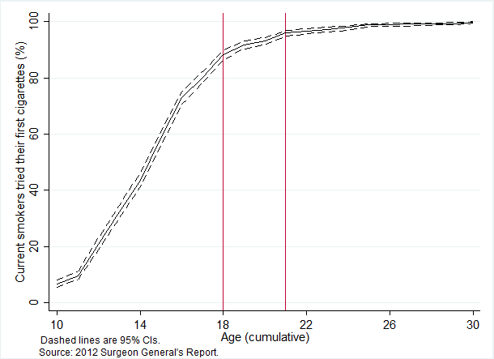
Motivation
Smoking kills around half a million each year in US (DHHS 2014)
Early signs of heart disease are found in young smokers (DHHS 2014)
96% of smokers begin smoking before age 21 (Surgeon General’s report 2012)

Slide 4
Raising MLSA to 21
Increases the monetary cost of purchasing tobacco ( e.g. hassle costs)
It could also signal under 21 users about the harm associated with smoking or vaping
Institute of Medicine (2015) projected a nationwide MLSA of 21 results in 249,000 fewer premature deaths and 50,000 fewer deaths from lung cancer by 2100.
Source: Institute of Medicine 2015 report

Slide 5
Research questions
Does raising MLSA to 21 (T21) reduce cigarette and e-cigarette use among adolescents?
How does the effect vary by gender, race, and ethnicity?
Is there any unintended consequences (effects on marijuana and alcohol use) ?

Slide 6
History of minimum legal sales age laws
Early MLSA laws appeared in the 1880s (Dorie et al. 2016)
By 1920, 14 state had T21 and the MLSA in 8 states ranged from 14 to 24
MLSA of 18 in 44 states and DC by 1990
Early evidence suggests the law was ineffective (DiFranza et al. 1987; Rudecki & Zdunick 1993)
Weak enforcement (Chaloupka & Grossman 1996)

Slide 7
MLSA compliance check inspections
1992 Synar Amendment by Congress improved enforcement
1997-1999 FDA retailer inspections—ended by Supreme Court’s rule in 2000
2010- FDA retailer inspections under TCA (Abouk and Adams 2017; Feng and Pesko 2019)
All enforced the federal MLSA of 18

Slide 8
Tobacco 21 (1)
T21 campaign lunched in 1996 by Preventing Tobacco Addiction Foundation
Needham, MA was the first locality that adopted T21 in 2005
As of mid-2018, 4 states (HI, CA, OR, & NJ) and around 281 cities and counties have adopted the law
Near 30% of the US population was under T21; 10 more states adopted in 2019
T21 was implemented nationally on December 20, 2019 under the Federal Food, Drug, and Cosmetic Act

Slide 9
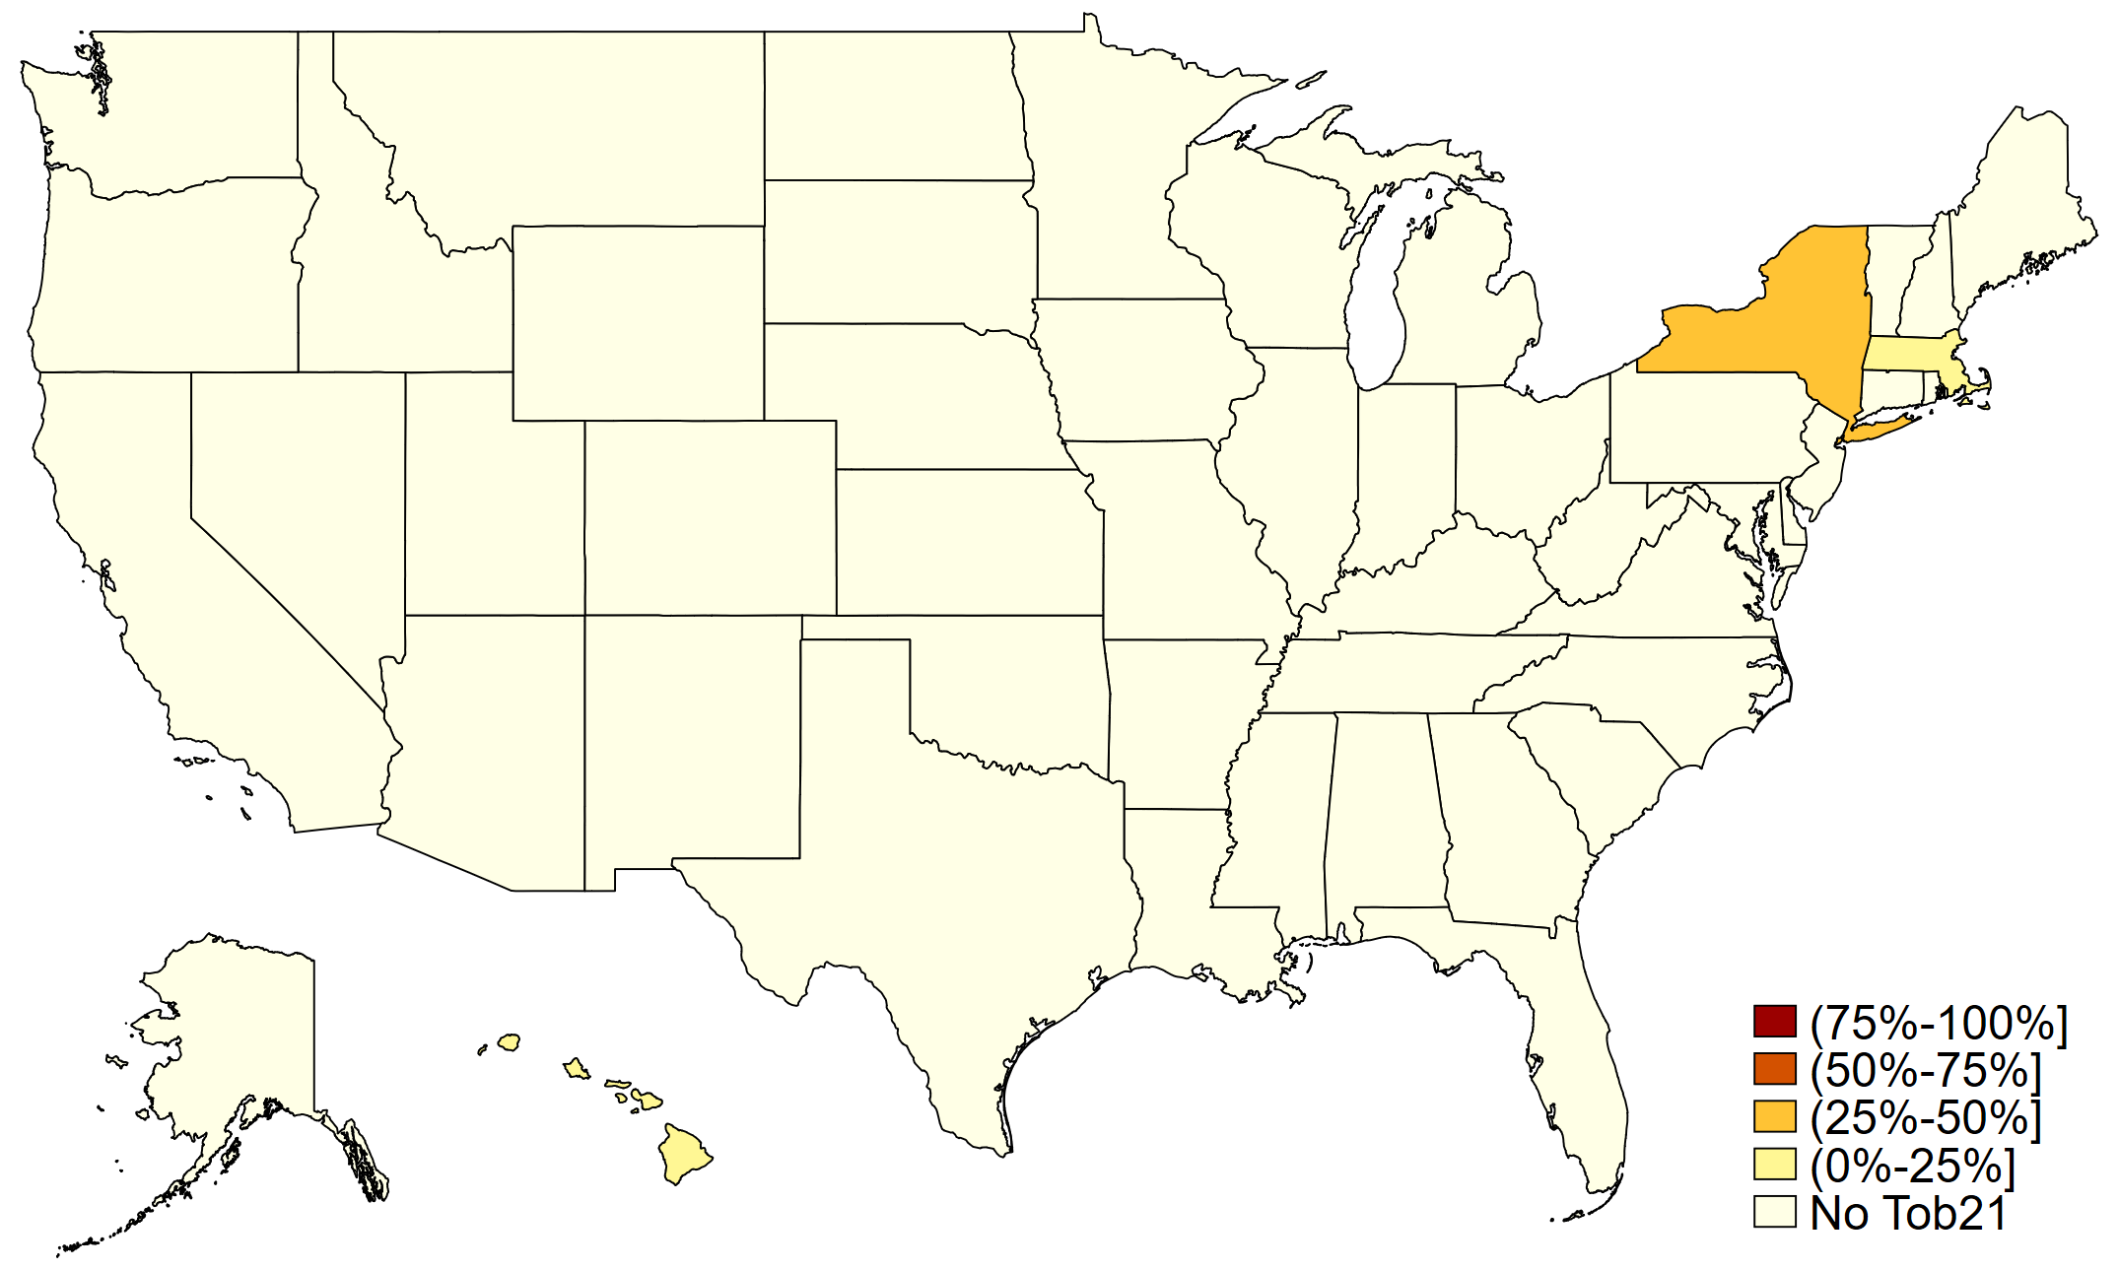
Tobacco 21 Laws in 2014 (% of State Population)

Slide 10
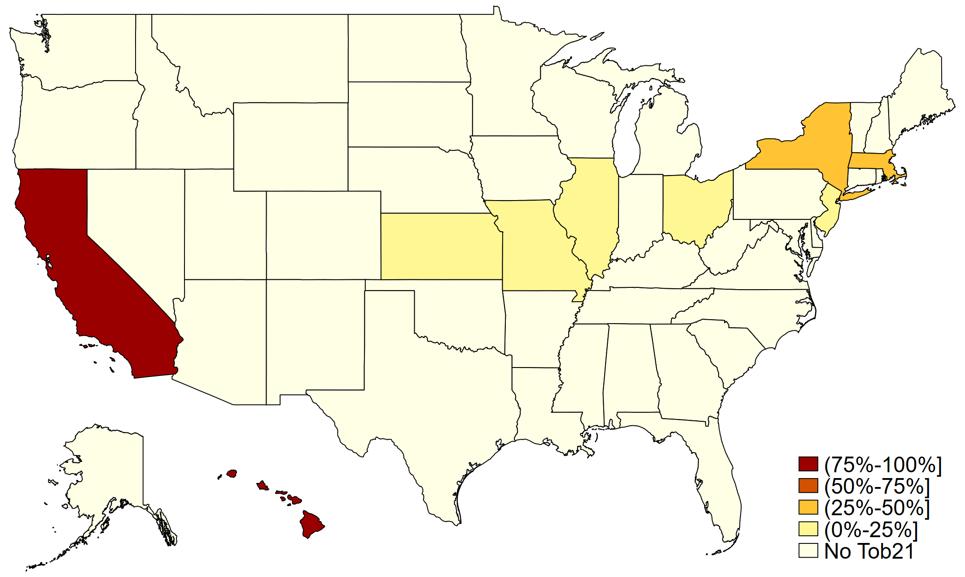
Tobacco 21 Laws in 2016

Slide 11
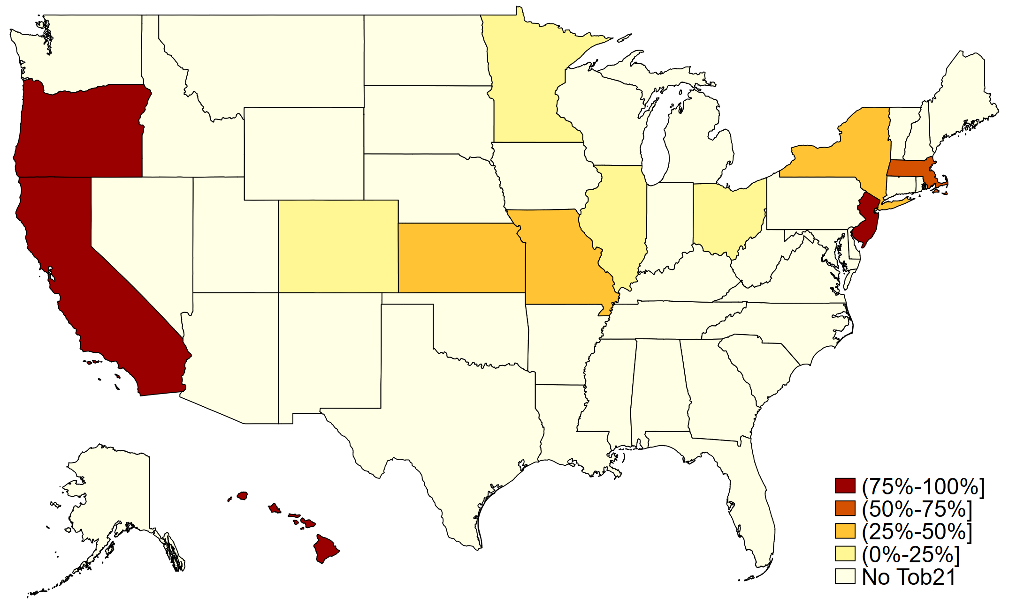
Tobacco 21 Laws as of June 2018

Slide 12
Tobacco 21 (2)
The campaign supports:
All nicotine products such as cigarettes and e-cigarettes excluding nicotine replacement products (gum, patch, etc.)
Significant enforcement provisions
No pre-emption against local authority
Ideally not include possession, usage, or purchase (PUP) penalties

Slide 13
Tobacco 21 enforcement
NYC 2014 Sensible Tobacco Enforcement (STE) law
Retailer’s license revoked or suspended if:
Tobacco products are sold to individuals under 21 two times in a three-year period
Enforcement was successful in NYC (Moreland-Russell et al. 2016)

Slide 14
Prior Research on MLSA of 18
Cigarette MLSA laws:
Yörük and Yörük (2016); Meier et al. (2019)
E-cigarette MLSA laws:
For cigarettes and e-cigarettes: Nguyen (2020); Dave et al. (2019); Abouk and Adams (2017)
For cigarettes only: Friedman (2015); Pesko, Faisal, Hughes (2016); Pesko and Currie (2019).

Slide 15
Prior Research on T21 (1)
Friedman et al. 2019
Setting: Online survey, 18-22-year-olds who had ever tried smoking or vaping
Study period: 2016-2017, 18-20-year-olds vs 21-22-year-olds
Results: 39% decline in in the odds of recent and current stablished smoking

Slide 16
Prior Research on T21 (2)
Friedman and Wu 2020
Setting: BRFSS SMART survey, 18-20-year-olds living in MMSAs
Study period: 2011-2016
Results: Nearly 30% decline in in the odds of current stablished smoking

Slide 17
Prior Research on T21 (3)
Ali et al. 2020: 13%-18% ↓ in tax-paid sales of cigarettes in CA and HI after T21
Bryan et al. 2020, NBER Working Paper
2009-2019
Study the T21 effects on 18-to-20-year-olds (BRFSS), 18-to-16-year-olds (YRBS)
Difference-in-differences method
Reduction in smoking, vaping, marijuana use, and alcohol use

Slide 18
Data
The Monitoring the Future (MTF) survey, nationally representative, 2012-2018
Approximately 50,000 8th, 10th, and 12th graders from 420 public and private secondary schools in the US
Conducted January-June of each year
Respondents answer questions about smoking, vaping, drinking, and substance abuse
Separate analysis on the following groups:
8th/10th graders
12th graders, under 18 (‘underage’)
12th graders, 18 and older

Slide 19
Variables (1)
Outcome variables
- Cigarette use past 30 days
- Average daily cigarettes smoked past 30 days
- E-cigarette use past 30 days (2014-2018)
- Frequency of days using e-cigarettes past 30 days (2014-2018)
- Cannabis use past 30 days
- Alcohol use past 30 days
Main policy variable: Binary variable equal to one if a state, county, or city had a T21 law at the time of the interview; and zero otherwise

Slide 20
Variables (2)
Individual-level variables:
- Age in years
- Sex
- Race
- Weekly labor and non-labor income (allowances from parents)
- Parents’ education categories
Policy variables:
- Cigarettes taxes (city, county, state, and federal)
- Beer taxes
- 100% smoke-free air laws (county-level)
- 100% vaping ban (county-level)
- E-cigarette sales ban and taxes
- Cannabis decriminalization

Slide 21
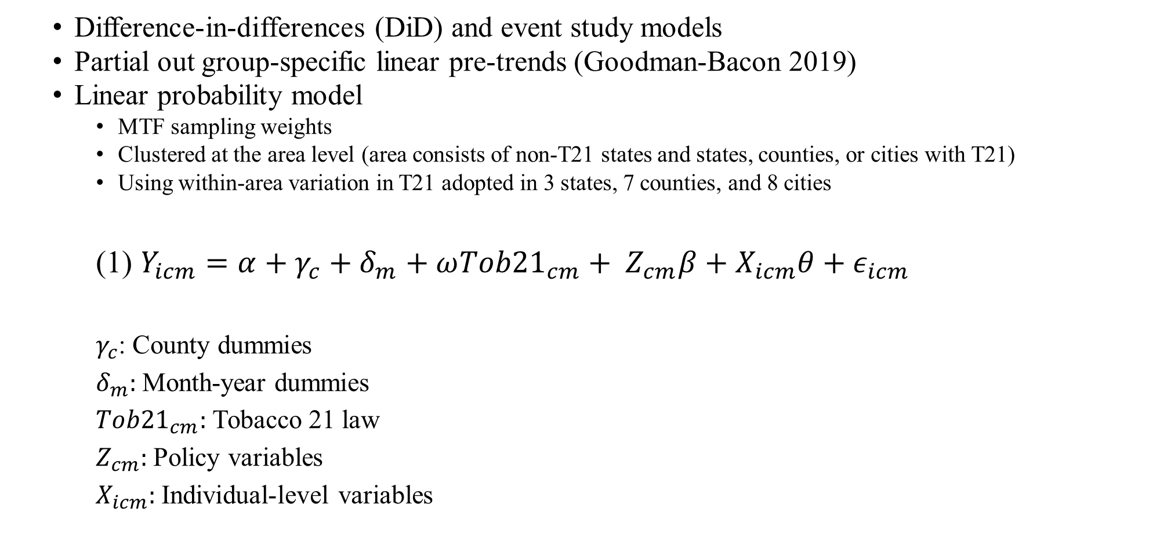
Estimation strategy
Difference-in-differences (DiD) and event study models
Partial out group-specific linear pre-trends (Goodman-Bacon 2019)
Linear probability model
MTF sampling weights
Clustered at the area level (area consists of non-T21 states and states, counties, or cities with T21)
Using within-area variation in T21 adopted in 3 states, 7 counties, and 8 cities
(1) $Y_{icm}=α+γ_{c}+δ_{m}+{ω{Tob21}_{cm}+ Z}_{cm}β+X_{icm}θ+ε_{icm}$
$γ_{c}$: County dummies
$δ_{m}:$ Month-year dummies
${Tob21}_{cm}:$ Tobacco 21 law
$Z_{cm}:$ Policy variables
$X_{icm}:$ Individual-level variables

Slide 22
Goodman-Bacon approach
Shows that any TWFE DiD estimates could be specified as a weighted average of all possible 2x2 DiD estimates
TWFE DiD estimates may be biased in presence of treatment heterogeneity
The bias might be even bigger if the effect changes over time
bacondecomp Stata command calculates and plots the 2x2 DiD weights

Slide 23
Summary statistics, 2012-2013
 | (1) | (2) | (3) | (4)
 | 8th/10th graders |  | Underage 12th graders
Variables | Non-adopters | T21 areas | Non-adopters | T21 areas
Cigarette use past 30 days | 0.08 | 0.05* | 0.15 | 0.10*
 | (0.27) | (0.22) | (0.36) | (0.30)
Average daily cigarettes past 30 days | 0.35 | 0.21* | 0.71 | 0.35*
 | (2.95) | (2.41) | (3.47) | (2.59)
Cigarette tax in 2018 $ city-county-state-federal | 1.58 | 2.06 | 1.72 | 2.20
 | (0.98) | (1.89) | (0.99) | (2.09)
Beer tax in 2018 $ | 0.31 | 0.20 | 0.28 | 0.20
 | (0.28) | (0.04) | (0.24) | (0.03)
E-cigarette Sales Ban | 0.12 | 0.85* | 0.15 | 0.82*
 | (0.32) | (0.36) | (0.35) | (0.39)
100% smoking ban in WRB (county-level) | 0.30 | 0.70* | 0.28 | 0.68*
 | (0.46) | (0.46) | (0.45) | (0.47)
100% vaping ban in WRB (county-level) | 0.02 | 0.18* | 0.02 | 0.11
 | (0.12) | (0.38) | (0.13) | (0.31)
Any e-cigarette tax (state/quarter) | 0.02 | 0.00* | 0.00 | 0.00
 | (0.16) | 0.00 | 0.00 | 0.00
MJ decriminalization | 0.24 | 0.83* | 0.24 | 0.96*
 | (0.42) | (0.37) | (0.43) | (0.20)
Observations | 43,197 | 12,586 | 7,844 | 3,089
Marijuana use past 30 days | 0.12 | 0.13* | 0.21 | 0.26*
 | (0.32) | (0.34) | (0.41) | (0.44)
Observations | 42,445 | 12,371 | 7,732 | 3,040
Alcohol use past 30 days | 0.18 | 0.20* | 0.38 | 0.46*
 | (0.39) | (0.40) | (0.49) | (0.50)
Observations | 41,382 | 12,051 | 7,620 | 3,016
Note: The asterisks indicate that the differences in each variable among non-adopters vs. T21 areas are statistically significant at the 0.05 level

Slide 24
Results— Cigarette use, 8th/10th graders, MTF 2012-2018
 | (1) | (2) | (3) | (4)
 | Cigarette use past 30 days |  | Average daily cigs.
8th/10th graders | [0.042] |  | [0.173]
Tobacco 21 | -0.0006 | -0.0068** | 0.0181 | -0.0380
 | (0.0030) | (0.0030) | (0.0451) | (0.0286)
County and year-month dummies | ✓ | ✓ | ✓ | ✓
Individual-level & policy variables | ✓ | ✓ | ✓ | ✓
Area-specific trends, Goodman-Bacon approach | × | ✓ | × | ✓
Observations | 194,844 | 194,844 | 194,844 | 194,844
R-squared | 0.053 | 0.048 | 0.020 | 0.019
*** p<0.01, ** p<0.05, * p<0.1

Slide 25
Results— Cigarette use, underage 12th graders, MTF 2012-2018
 | (1) | (2) | (3) | (4)
 | Cigarette use past 30 days |  | Average daily cigs.
Underage 12th graders | [0.088] |  | [0.330]
Tobacco 21 | -0.0246*** | -0.0229** | -0.0494 | -0.0641
 | (0.0089) | (0.0089) | (0.1303) | (0.1344)
County and year-month dummies | ✓ | ✓ | ✓ | ✓
Individual-level & policy variables | ✓ | ✓ | ✓ | ✓
Area-specific trends, Goodman-Bacon approach | × | ✓ | × | ✓
Observations | 36,484 | 36,484 | 36,484 | 36,484
R-squared | 0.068 | 0.058 | 0.037 | 0.034
*** p<0.01, ** p<0.05, * p<0.1

Slide 26
Results— E-cigarette use, 8th/10th graders, MTF 2014-2018
 | (1) | (2) | (3) | (4)
 | E-cigarette use past 30 days |  | E-cigarette use frequency
8th/10th graders | [0.096] |  | [1.215]
Tobacco 21 | 0.0024 | -0.0143 | 0.0178 | -0.0422
 | (0.0121) | (0.0120) | (0.0377) | (0.0387)
County and year-month dummies | ✓ | ✓ | ✓ | ✓
Individual-level & policy variables | ✓ | ✓ | ✓ | ✓
Area-specific trends, Goodman-Bacon approach | × | ✓ | × | ✓
Observations | 51,377 | 51,377 | 51,377 | 51,377
R-squared | 0.067 | 0.066 | 0.071 | 0.072
*** p<0.01, ** p<0.05, * p<0.1

Slide 27
Results— E-cigarette use, underage 12th graders, MTF 2014-2018
 | (1) | (2) | (3) | (4)
 | Cigarette use past 30 days |  | Average daily cigs.
Underage 12th graders | [0.128] |  | [1.279]
Tobacco 21 | 0.0069 | 0.0010 | 0.0085 | 0.0111
 | (0.0208) | (0.0273) | (0.0717) | (0.0968)
County and year-month dummies | ✓ | ✓ | ✓ | ✓
Individual-level & policy variables | ✓ | ✓ | ✓ | ✓
Area-specific trends, Goodman-Bacon approach | × | ✓ | × | ✓
Observations | 15,330 | 15,330 | 15,330 | 15,330
R-squared | 0.095 | 0.095 | 0.112 | 0.107
*** p<0.01, ** p<0.05, * p<0.1

Slide 28
Effect by gender, race and ethnicity, underage 12th graders
 | (1) | (2) | (3) | (4) | (5) | (6)
Panel A: Cigarette use past 30 days | Males [0.102] | Females [0.077] | White Non-Hispanic [0.118] | Black Non-Hispanic [0.052] | Hispanic [0.076] | Other Non-Hispanic [0.055]
Tobacco 21 | -0.0427*** | -0.0143 | -0.0039 | -0.0484** | -0.0685*** | -0.0411
 | (0.0122) | (0.0128) | (0.0177) | (0.0190) | (0.0209) | (0.0361)
Observations | 16,254 | 20,230 | 21,072 | 4,891 | 6,662 | 3,537
R-squared | 0.084 | 0.079 | 0.081 | 0.121 | 0.114 | 0.184
Panel B: E-cigarette use past 30 days | [0.155] | [0.108] | [0.154] | [0.149] | [0.117] | [0.105]
Tobacco 21 | -0.0130 | 0.0261 | 0.0565* | 0.0383 | -0.0293 | 0.0128
 | (0.0379) | (0.0199) | (0.0307) | (0.0544) | (0.0342) | (0.0380)
Observations | 6,709 | 8,621 | 8,689 | 2,115 | 2,872 | 1,519
R-squared | 0.121 | 0.101 | 0.117 | 0.186 | 0.185 | 0.238
*** p<0.01, ** p<0.05, * p<0.1

Slide 29
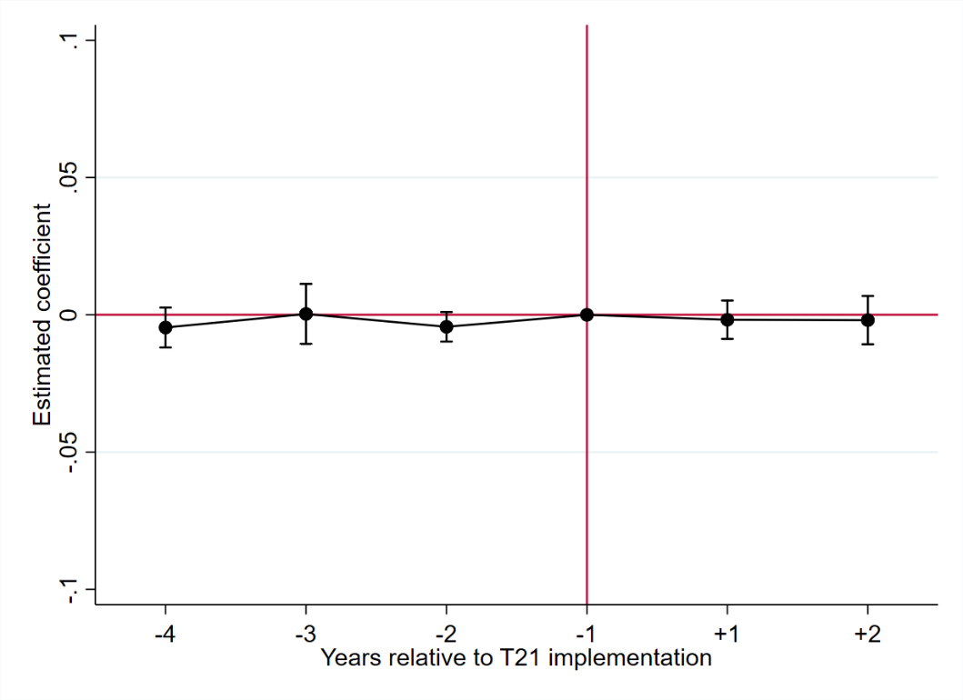
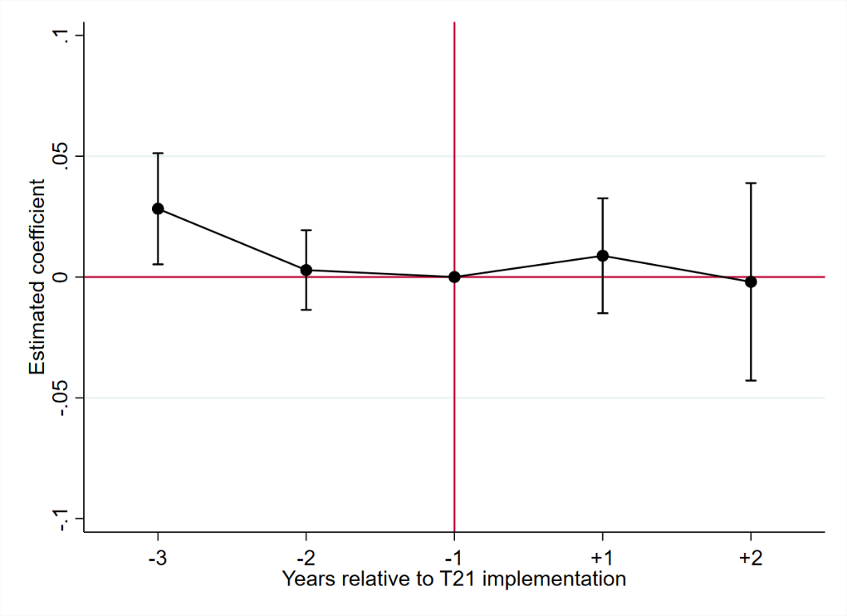
Event study—8th/10th graders
Cigarette use past 30 days
E-cigarette use past 30 days

Slide 30
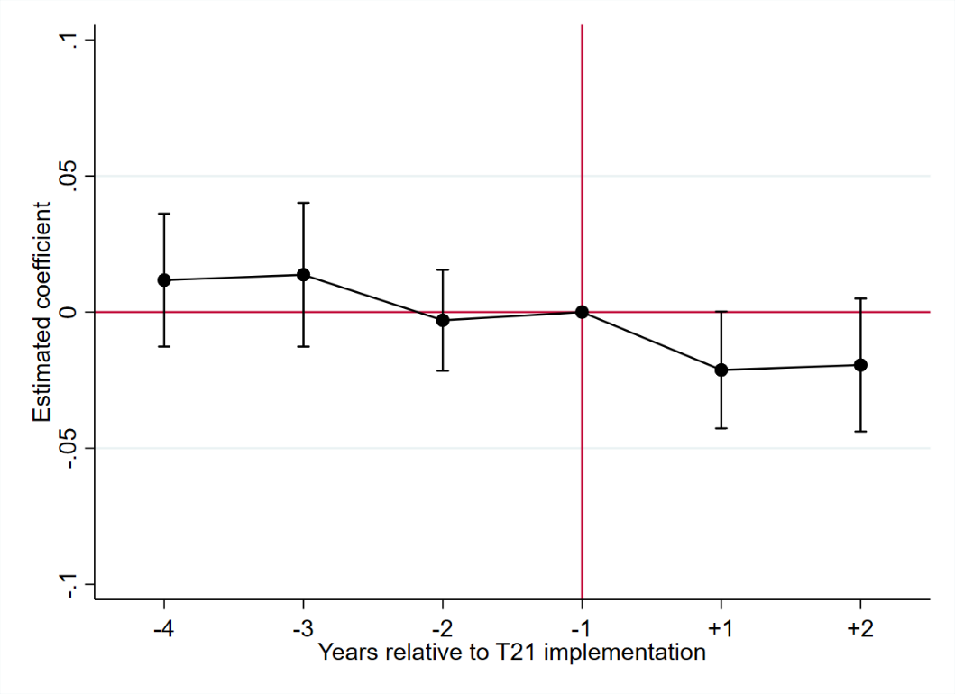
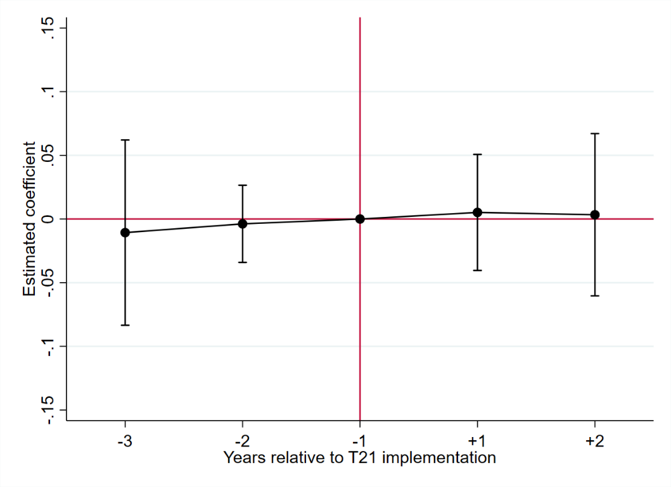
Event study— underage 12th graders
Cigarette use past 30 days
E-cigarette use past 30 days

Slide 31
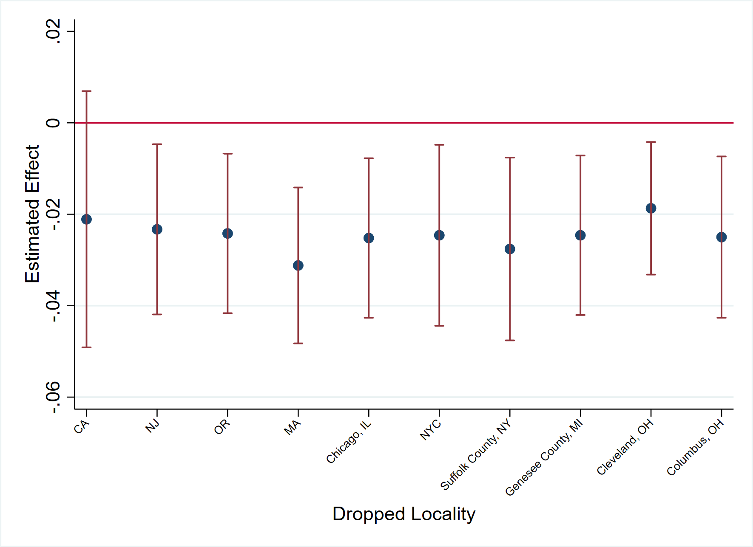
Leave-one-out analysis— cigarette use, underage 12th graders
*** p<0.01, ** p<0.05, * p<0.1

Slide 32
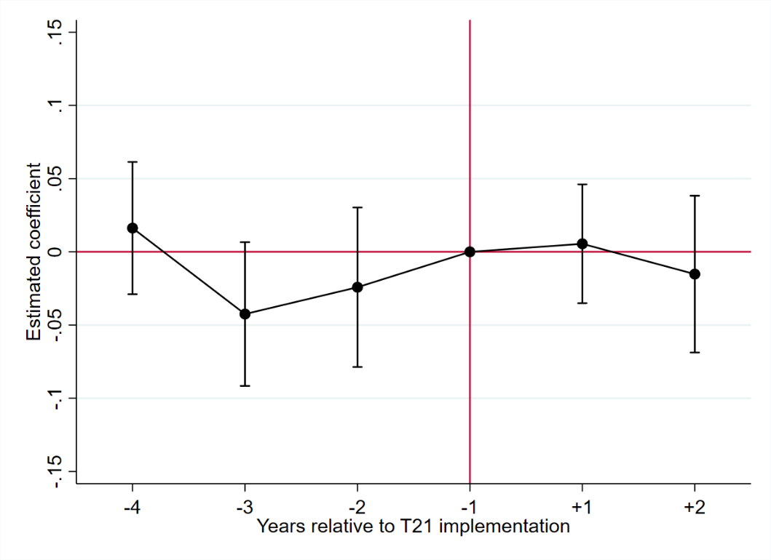
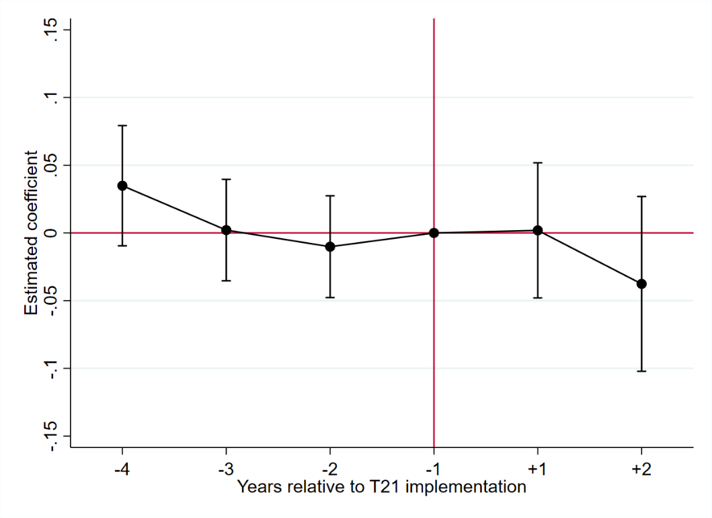
Event study—underage 12th graders, other substances
Cannabis use past 30 days
Alcohol use past 30 days

Slide 33
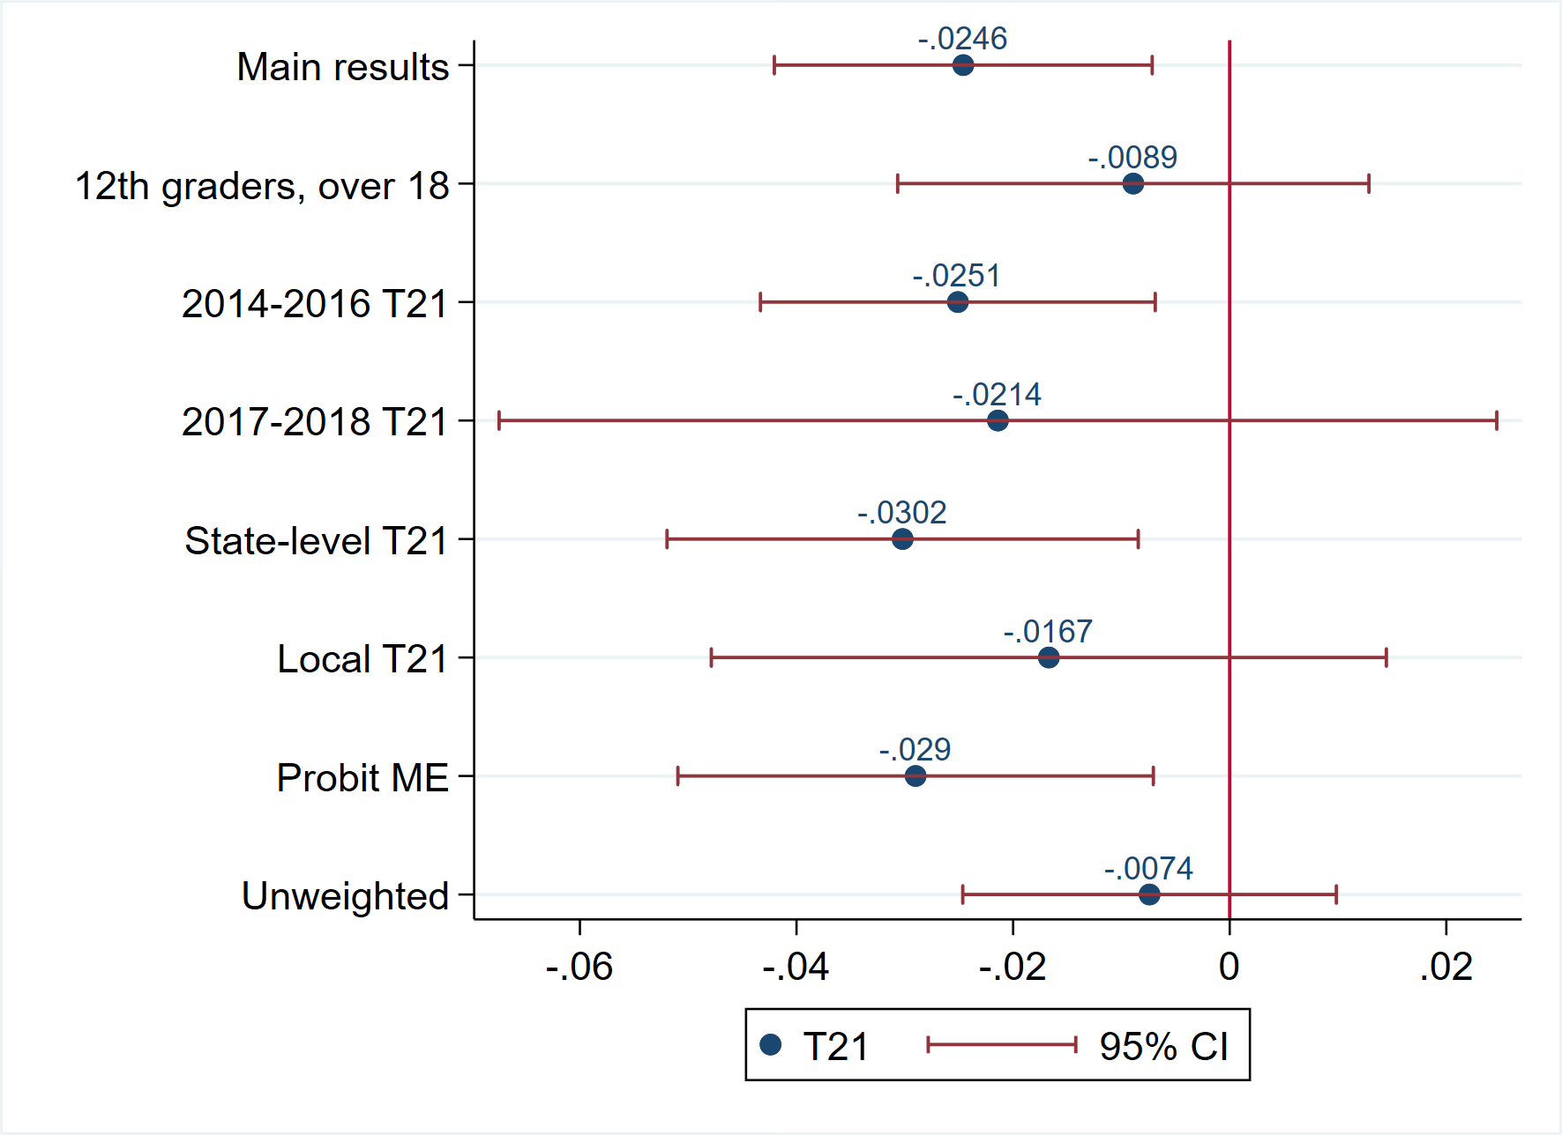
Additional estimations

Slide 34
Summary
T21 reduces cigarette use by 28.5% among underage 12th grades
Consistent with findings in Friedman et al. (2019) and Friedman and Wu (2020)
Effects are bigger among males and minorities
Little evidence of T21 affecting 8th/10th graders
No effect on e-cigarette use in any group
No evidence of cannabis or alcohol substitution with tobacco—No unintended consequence

Slide 35
Thank you!
aboukr@wpunj.edu

